Slide 1
CIS598 - Final Presentation
Subtitle Generator
(Voice recognition)
Members: Sixiang Zhang, Shaoxiang Zeng
Advisor: Dr.Hsu

Slide 2
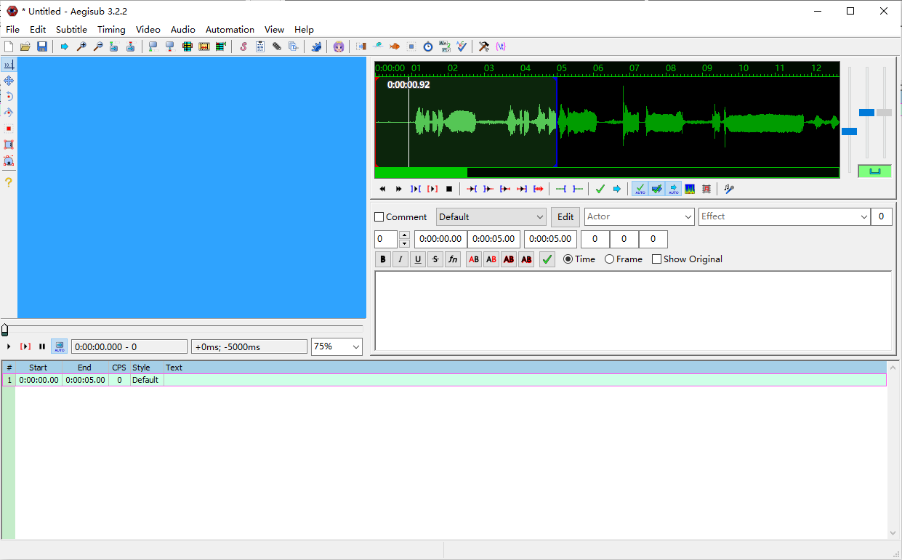
Introduction
Goal
Nowadays, most subtitle are written manually. One video website like Youtube, subtitle can be automatically generated.
However, volunteers still needs to spend lots of time on it, using tools such as Aegisub or Adobe Premiere.
Help individual creators generate subtitle efficiently, with the help of voice recognition.

Slide 3

Basic Idea
What should be done:
Support various types of video input
Such as mp4, avi, flv
Extract audio from video
Split audio into pieces (or sentences)
Convert audio pieces to text
Generate subtitle file
Source: https://cloud.google.com/images/products/speech/speech-api-lead.png

Slide 4
Sixiang’s Work

Slide 5

Technical Detail
Source: https://developer.nvidia.com/sites/default/files/akamai/designworks/images/ffmpeg.png
Video Processing - ffmpeg
A complete, cross-platform solution to record, convert and stream audio and video.
Support various platforms - Linux, Windows, MacOS
Can be called with subprocess library in Python

Slide 6
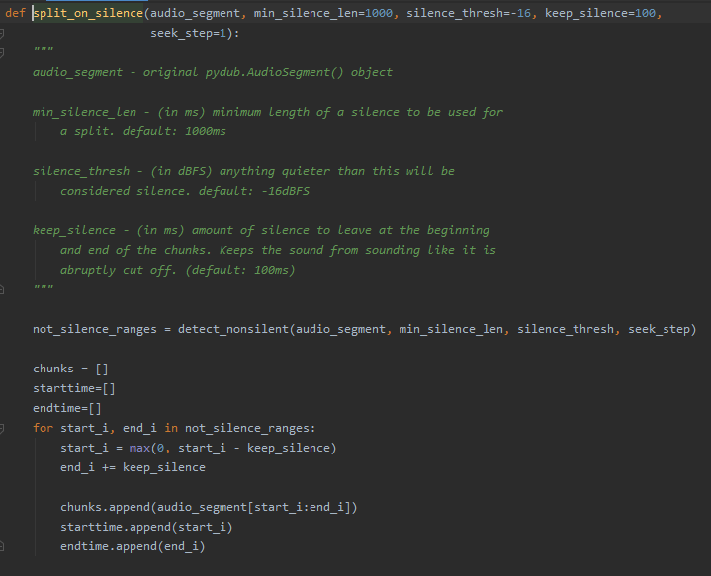
Technical Detail
Audio Processing - pydub
Manipulate audio with a simple and easy high level interface
Variable we added:
starttime[]
endtime[]

Slide 7
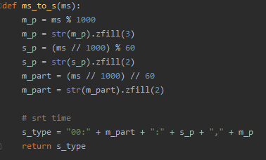
Technical Detail
API Contact - speech recognition package
An interface that help interact with google speech recognize service
Subtitle generate

Slide 8
Technical Detail
Model Training -
Develop environment:
Ubuntu 18.04:
Hardware:
GTX1050 (Notebook)
Library & Tool:
Paddle Paddle - DeepSpeech2
open-source Automatic Speech Recognition engine
Required Parts:
GPU Support - NVDIA driver 430.5,
CUDA 10.1
Neural Network Support - cuDNN 7.65
Data sets:
Libri Speech
- read audiobooks voice
- originally supported by DeepSpeech 2
Mozilla Common Voice
- voice from volunteers
- need data cleaning
- details will be introduced by Shaoxiang

Slide 9
Demo-API version

Slide 10
Shaoxiang’s Work

Slide 11
Technical Detail
Common voice dataset processing:
Convert all files to .wav which can accept by DeepSpeech2
Clean & get data with pandas (head 70000)
Generate manifest with .tsv file

Slide 12
Technical Detail
Model Error rate
wer = word error rate
TestSet: test-clean
Tiny: average about 90% wer
100 hours：average about 15 - 20% wer
460 hours：average about 5 - 10% wer
Hybrid dataset with Common Voice: Currently training
Libri Speech well trained: <1% wer
TestSet: test-other
Tiny: average about 95 - 100% wer
100 hours：average about 35 - 40% wer
460 hours：average about 15 - 25% wer
Hybrid dataset with Common Voice: Currently training
Libri Speech well trained: about 3 - 8% wer

Slide 13
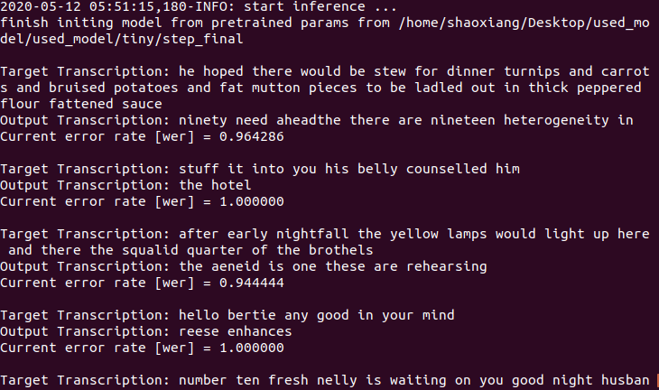
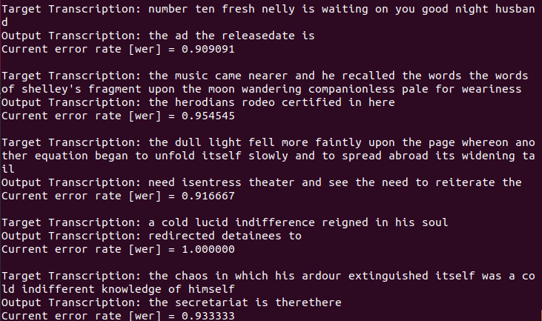
Technical Detail (Error rate example)
Error rate : tiny_test-clean

Slide 14
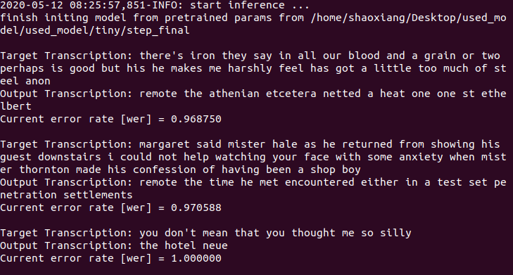
Technical Detail
Error rate: tiny_test-other

Slide 15
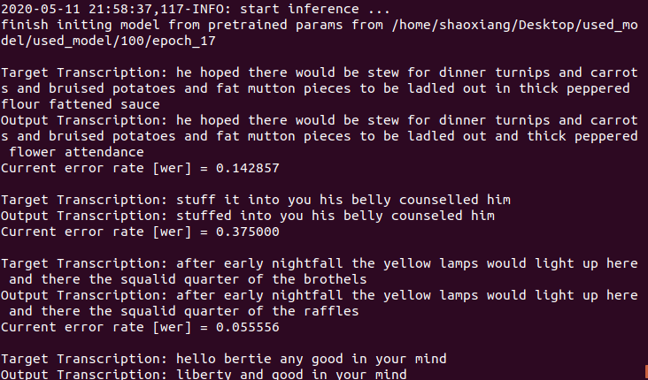
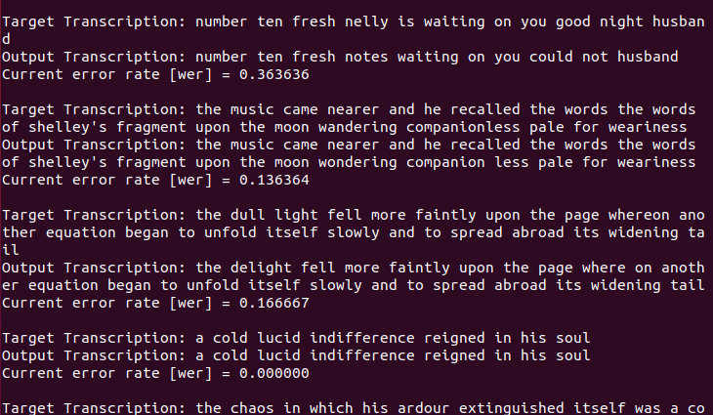
Technical Detail
Error rate - 100_test-clean

Slide 16
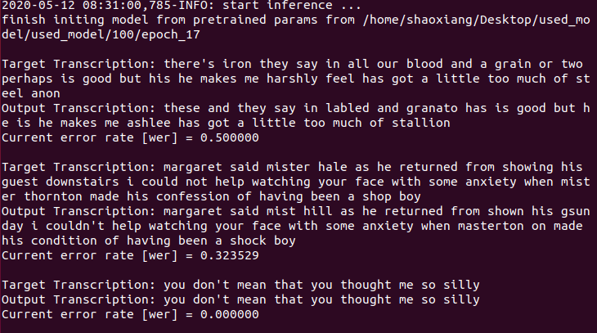
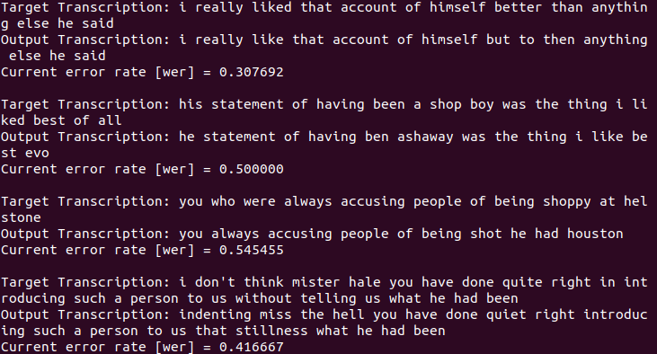
Technical Detail
Error rate: 100_test-other

Slide 17
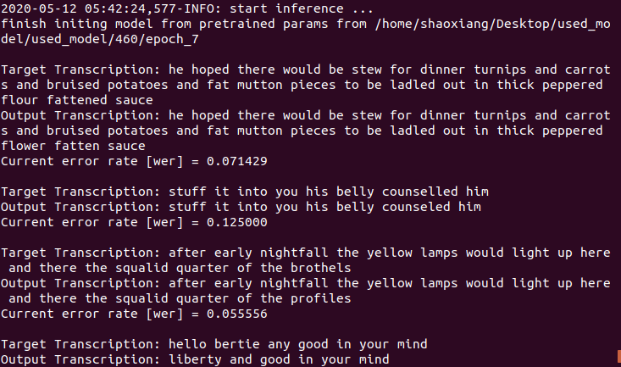
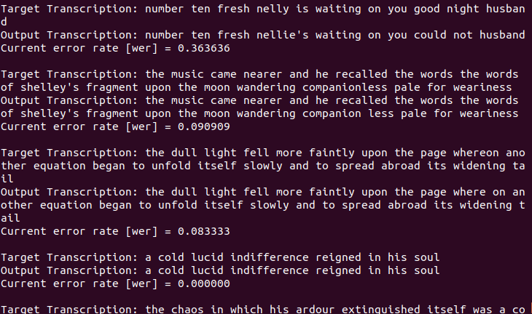
Technical Detail
Error rate: 460_test-clean

Slide 18
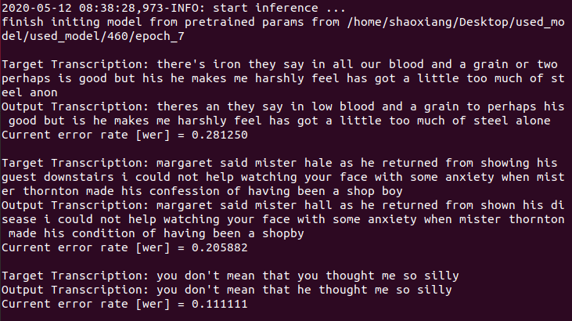
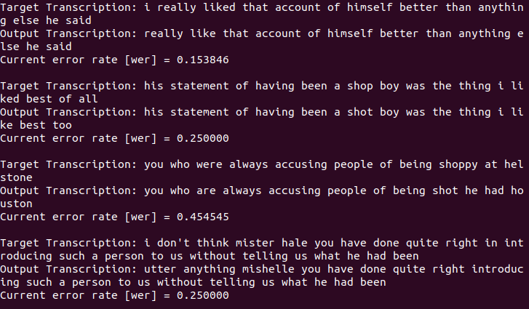
Technical Detail
Error rate: 460_test-other

Slide 19
Technical Detail
Model Appling - Using own pretrained models to print test datasets’ transcript
Environment: Ubuntu 18.04
Tools and Library Used: paddle (paddle.fluid),
DeepSpeech2
Dataset: Libri Speech (test-clean)
Language: English

Slide 20
Demo-Model version

Slide 21
Challenge
Accuracy to detect a sentence
currently using hard coded parameters
min_silence_len, silence_thresh
Accuracy when using API
noise, accent, bgm
Accuracy using model
need more datasets and more time
need to find better parameters for training
Dataset format
Training time
Model Application

Slide 22
Future Improvement
Apply model to our program
Train with bigger data sets and longer time
Figure out a better way to split audio
Maybe multi process for splitting & API contact

Slide 23
Thank you

